Slide 1

Auburn Rose Society Presents Roses and Where They Come From
Auburn Rose Society
Meat and Potatoes Meeting
January 11, 2026
Notes:
Content on these slides is taken directly from the Alabama Cooperative Extension System publication 'Growing Roses' (ANR-0157), pages 1–3.

Slide 2
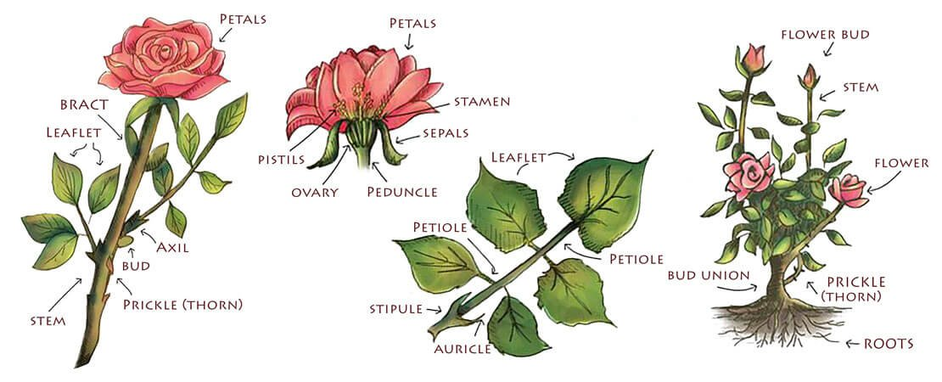
Anatomy of a Rose
Notes:
This slide shows the anatomy of a rose. Point out petals first, then sepals at the base. Explain stamens as the pollen-producing male parts and the pistil as the female part. Mention that hips form when flowers are not deadheaded.

Slide 3
Where do Roses Come From?
Origins are thought to be from ancient times as old as pre-historic eras. Oldest fossil was found in Colorado
3000 – 5000 years ago – Persia & Middle East
2000 B.C. – Ancient China
500 B.C. – 400 A.D. – Greek and Roman eras
1400s – 1600s – Medieval and Renaissance
1700s – 1800s – Great Turning Point
1867 – Birth of Modern Roses
1900 – today – Modern Rose era

Slide 4
Asia (China, Japan, Korea, and India)
Birthplace of most roses 60-70%
Without Asian roses, modern rose would only bloom once per year

Slide 5
Middle East
Iran and Turkey
This region gave us damask roses famous for: intense perfume, rose oil and rose water

Slide 6
Europe
France, Italy and England
European species roses:
Bloomed once in Spring
Were extremely hardy
Formed the backbone of old garden roses before modern hybrids

Slide 7
North America
Native wild roses such as prairie and woodland species
Contributed cold hardiness and disease resistance
Important in modern breeding programs

Slide 8
How we got modern roses
Crossbreeding from different regions
Asian -> Repeat blooms
Middle Eastern -> Fragrance
European -> flower form and hardiness
North America -> toughness and resilience

Slide 9
Historical Origins
Central Asia: The widely accepted birthplace of roses, from where they spread globally.
Europe/Mediterranean: Important for ancient varieties like R. gallica, Damask, and Alba roses, noted for early breeding of double flowers.
China: A crucial source for repeat-flowering (everblooming) roses (R. chinensis), which revolutionized breeding when introduced to Europe in the 18th century, creating modern garden roses.
Notes:
This slide shows the anatomy of a rose. Point out petals first, then sepals at the base. Explain stamens as the pollen-producing male parts and the pistil as the female part. Mention that hips form when flowers are not deadheaded.

Slide 10
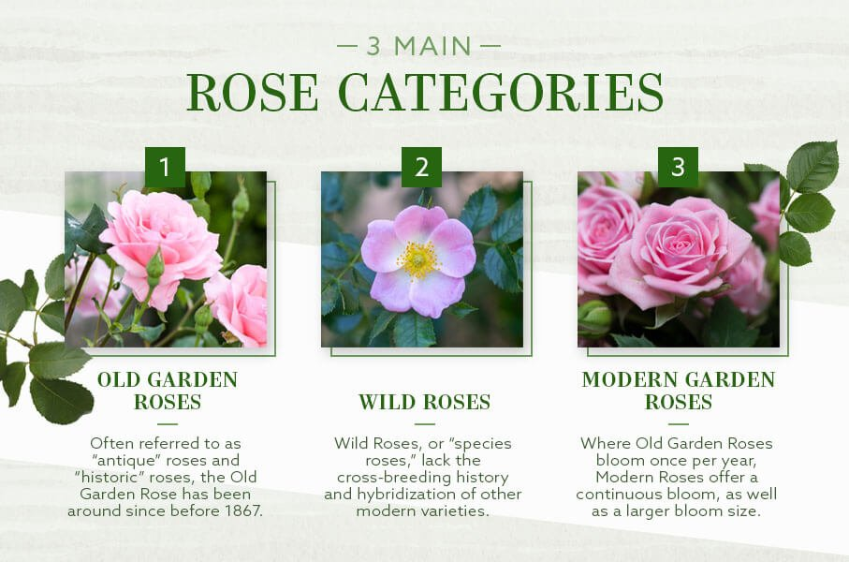
3 Main Types of Roses-Categories

Slide 11
Species Roses (Wild Roses)
Often called wild roses
Usually single‑petaled
Typically bloom once per season
Very hardy and disease resistant
Examples: Rosa banksiae, Rosa laevigata
Notes:
Species roses are wild roses and the foundation of all modern roses. They usually bloom once and are extremely tough.

Slide 12
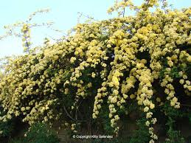
Species Rose Examples
Lady Bank Rose
Notes:
Use these photos to show how simple species rose blooms look compared to modern roses.

Slide 13
Old Garden Roses (Pre‑1867)
Cultivated before 1867
Known for fragrance and form
Includes many historic rose classes
Some bloom once, others repeat
Notes:
Old garden roses were grown before 1867. They are famous for fragrance and historic value.

Slide 14
Old Garden Rose Classes
Gallica, Damask, Alba, China, Tea, Bourbon, Noisette, Moss, Centifolia
In 1966 ARS defined these as roses that existed prior to 1867
Notes:
These photos represent the wide variety found within old garden roses.

Slide 15
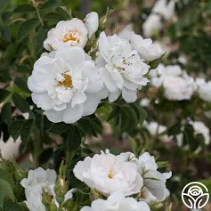
Alba
Known as white roses
Upright and often climbers
Dense blue/green foliage
Disease resistant
Examples – “Alba Maxima”, “Great Maiden’s Blush”
Notes:
These photos represent the wide variety found within old garden roses.

Slide 16
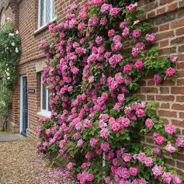
Bourbon
Developed from hybrid china roses
1st repeat flowering roses
Derived from location of first members of the class – Ile De Bourbon
Range 2 – 15 feet tall
Example – “Zephrine Drouhin” – nearly thornless and super fragrant; climbing habit covered in pink blooms
Notes:
These photos represent the wide variety found within old garden roses.

Slide 17
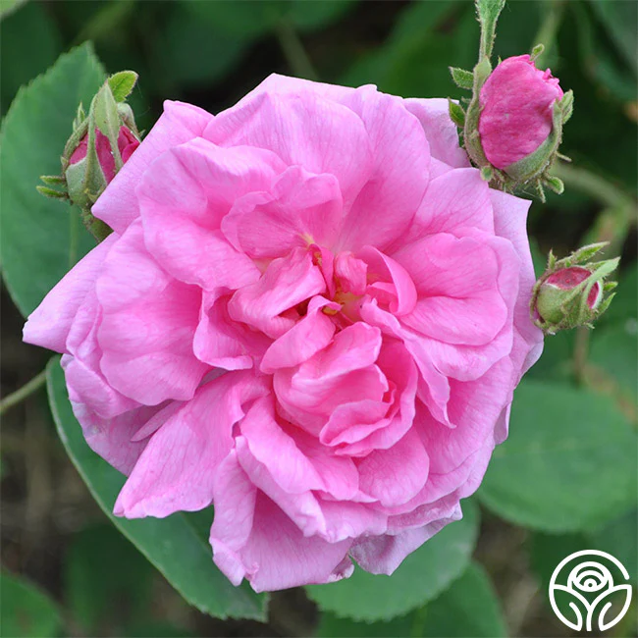
Centifolia
Dutch hybridized roses
Contain more than 100 petals
4 – 8 ft tall
Winter hardy and bloom once
“Cabbage” roses
Featured in Dutch paintings of 17th century
Example “Cabbage Rose”, “Dutch Provence”
Notes:
These photos represent the wide variety found within old garden roses.

Slide 18
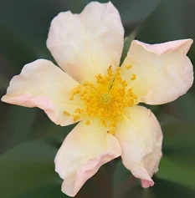
China
Repeat bloom, small clusters
Variable in height, few thorns
Not below USDA Zone 7
Originated in SE Asia
Important historical groups of roses
Example “Mutabilis” – “Butterfly Rose” whose petals go from yellow to pink to bronze
Notes:
These photos represent the wide variety found within old garden roses.

Slide 19
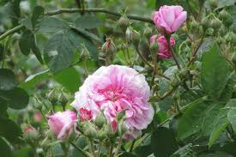
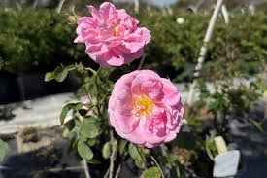
Damask
Best known for intense heavy fragrance
Range from 3 – 6 ft
Some varieties are repeat blooming
Traditionally used for rose oil, perfume and rose water
Examples- “Ispahan”, “Celsiana”, “York and Lancaster”, “Kazanlik”
Notes:
These photos represent the wide variety found within old garden roses.

Slide 20
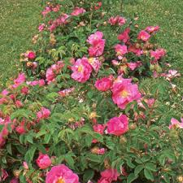
Gallica
Small, 3-4 ft
Winter hardy
Blooms are fragrant, come in brilliant colors and once blooming
Oldest cultivated roses in Europe
Not very disease resistant
Hybridized for fragrance and color
Examples – “Apothecary's Rose”, “Tuscany Superb”, “Charles de Mills”
Notes:
These photos represent the wide variety found within old garden roses.

Slide 21
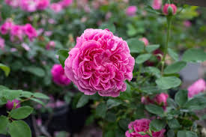
Hybrid Perpetual
Blooms are full and spectacularly large
Popular before development of hybrid teas
Larger blooms
Popular in 19th century
Typically 6 ft
Fragrance and color range, but mostly pink and red
Examples – “Paul Neyron”, “Marchesa Boccella”
Notes:
These photos represent the wide variety found within old garden roses.

Slide 22
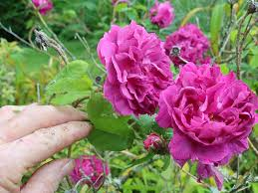
Moss
Mossy thorn growth on the peduncle just below the bloom and sepals
Smells like pine trees when rubbed between fingers
Winter-hardy
3-6 ft tall and some varieties are repeat blooming
Examples – “'William Lobb”, 'Henri Martin', 'Salet'
Notes:
These photos represent the wide variety found within old garden roses.

Slide 23
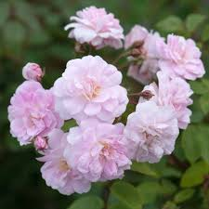
Noisette
Originated by Phillip Noisette from Charleston, South Carolina
Later introduced in France in 1817
Expansive (up to 20 ft), fragrant and repeat blooms
Examples – “Champney’s Pink Cluster”, “Perle D’or”
Notes:
These photos represent the wide variety found within old garden roses.

Slide 24
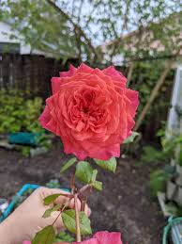
Portland
Derived from crosses involving hybrid Gallica, Damask, Centifolia and Hybrid China.
Small in stature, usually 4 ft tall
Repeat bloomers (unusual among old roses) and short peduncle
Blooms are quartered and cupped, short stems
Named in honor of the Duchess of Portland
Examples – “Comte de Chambord”, “Rose de Rescht”, “Jacques Cartier”, “Portlandia”, “Duchess of Portland”
Notes:
These photos represent the wide variety found within old garden roses.

Slide 25
Rugosa Roses
Tough old fashioned roses native from coasts of Japan, Korea, and eastern Russia.
Beloved for their hardiness, disease resistance and fragrance
4-7 feet tall
Shrubby dense and spreading
Ex: Hansa, Blanc Double de Coubert, Rosarie de l’Hay, and Therese Bugnet
Single double flowers
Typically white, blush pink, magenta, and deep rose
Strong clove or old rose fragrance
Blooms heavy in spring and repeats all season
Produce excellent rose hips
Cold hardy, salt tolerant

Slide 26
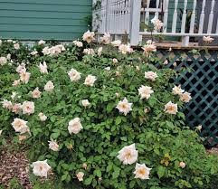
Tea
Not to be confused with hybrid teas
Variable in height
Best cultivars are climbing teas
Large blooms on weak stems – resulting in drooping or nodding flowers
Immediate ancestor of the modern hybrid tea roses
Does not tolerate cold well
Grow best when only lightly pruned
Examples – “Duchesse de Brabant”, “Mrs. B.R. Cant”, “Magnolia Rose”, “Safrano”
Notes:
These photos represent the wide variety found within old garden roses.

Slide 27
Ayrshire, Boursault
Ayrshire – climbing, sprawling roses from Scotland – once blooming
Boursault – thornless, rambling once blooming – developed by French gardener
Notes:
These photos represent the wide variety found within old garden roses.

Slide 28
Modern Roses (Post‑1867)
Developed after the rose 'La France' (1867)
Usually repeat bloomers
Bred for flower form and color
Most common roses grown today
Notes:
Modern roses were developed after the introduction of 'La France' in 1867. Most roses grown today fall into this category.

Slide 29
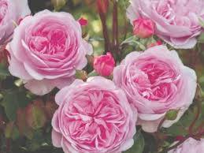
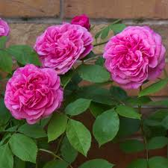
English Roses
Bred by David Austin mid 20th century
Considered modern despite old-fashioned appearance
Old rose form – cupped, rosette and quartered blooms
String fragrance – myrrh, tea, old rose and fruit
Repeat bloomers
Improved disease resistance
Variety of colors
Shrubs or short climbers
Good for cottage gardens
“Olivia Austin”, “Gertrude Jekyll”
Notes:
Explain how modern roses vary widely in size and form but usually repeat bloom.

Slide 30

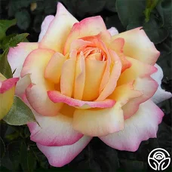
Hybrid Tea
One single bloom on a robust stem
30-50 petals
1st “La France” 1857
“Mr. Lincoln”
Peace in 1945
Bred by Meilland

Slide 31
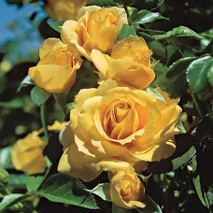
Floribunda
Flowers in abundance
Clusters with more than one bloom and flower at any one time
Ability to bloom continually versus hybrid tea
Repeat bloomer and many are fragrant
Example: “Julia Child”

Slide 32
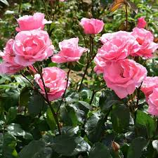
Grandiflora
Resemble floribunda but larger blooms
Cross hybrid tea and floribunda
Larger bush but more abundant and smaller blooms than hybrid tea
Example: “Queen Elizabeth”

Slide 33
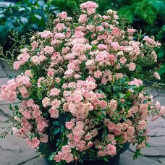
Polyantha
Generally smaller than floribunda but sturdy
Have large clusters of small 1 inch diameter blooms
Often used for edging and hedges
Closely related to climbing roses
Example “Fairy”

Slide 34
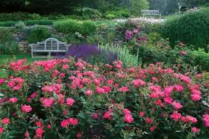
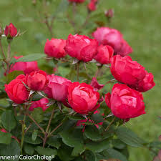
Shrub
Old garden and modern is a catch-all
Grow large clusters of flowers
Sprawling habit and used in landscape; can grow 5-15 feet
Typically hardy and do not require dead-heading
Examples: “Knock Out”, “Oso Easy”

Slide 35
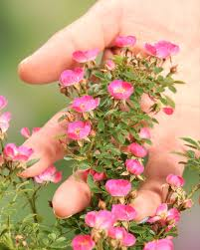
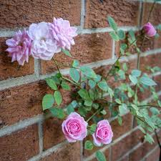
Miniature and Miniflora
Novelty and versatility
Avg height 15 – 30 inches
Flower form and foliage mini versions of hybrid tea and floribunda
“Be My Baby”, “Cutiepie”
Miniflora – adopted by ARS in 1999 falling between miniature and floribunda – “Jeanne Lajoie”

Slide 36
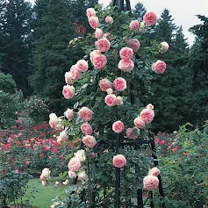
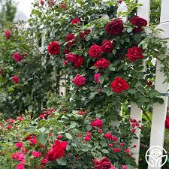
Climbers
Usually trained on a support – trellis, posts, etc. 8 -15 feet typically
Require heavy pruning annually
Flowers are large and may be used for cutting
Bloom best when canes are trained horizontally
Examples: “Eden climber”, “Don Juan”, “Peggy Martin”

Slide 37
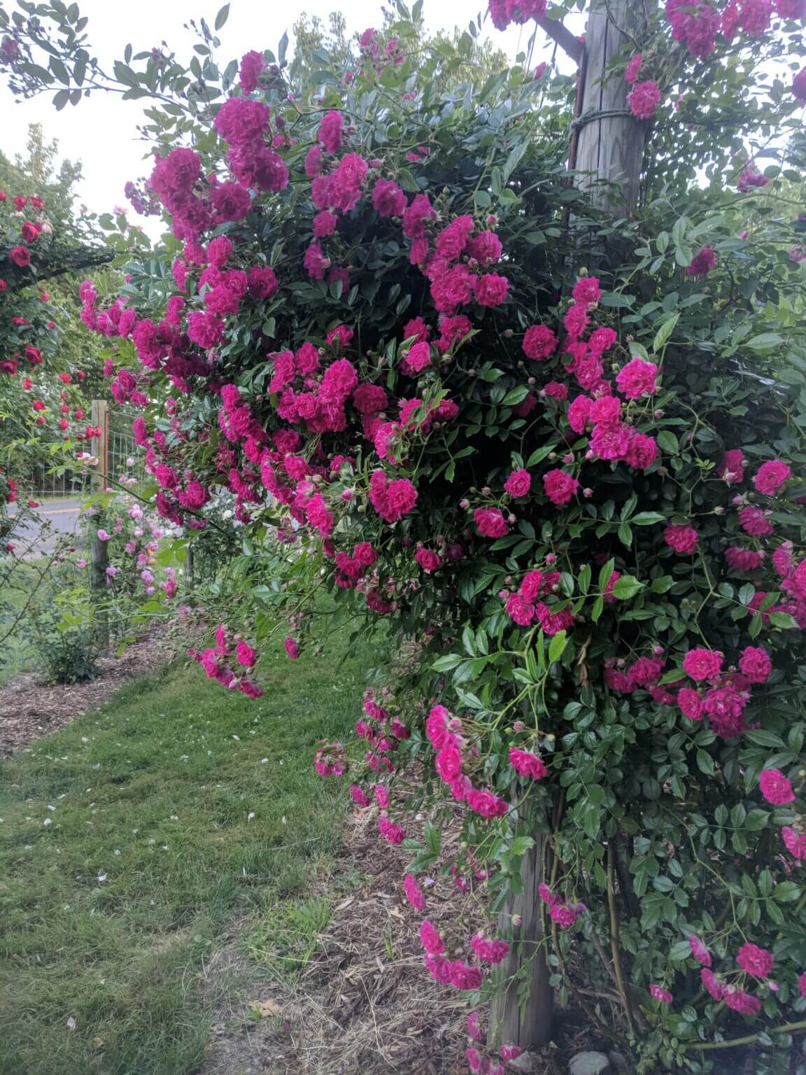
Ramblers
Older classification with flexible canes that can be trained
Smaller flowers than climbers but can grow much larger in general up to 30 ft
Typically bloom once in Spring
Typically yellow, white, pink versus climbers having more color variety
Example: “Super Excelsia”, “Dr W Van Fleet”

Slide 38
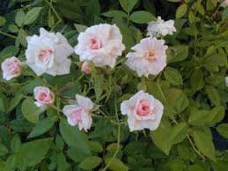
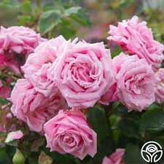
Earthkind
Belinda’s Dream
Cecile Brunner

Slide 39
Why Classification Matters in Alabama (Zone 8b)
Heat and humidity influence rose performance
Disease resistance is critical
Some classes outperform others in the South
Notes:
This slide explains why choosing the right rose type matters in Alabama’s heat and humidity.

Slide 40
Q & A
Notes:
This slide explains why choosing the right rose type matters in Alabama’s heat and humidity.

